Slide 1
PRESENTATION BY GROUP 26
PROJECT TITLE:
DESIGNING A TRAFFIC LIGHT SYSTEM

Slide 2
GROUP MEMBERS
NAME | DEPARTMENT | MATRICLE
TEBOH MANOILLA | CE | FE23A167
TEMFA NKOMBONG FORTUNEE | CE | FE23A168
TENKEN MANPLA ULRICH | CE | FE23A170
THELMA MARLEY NDAYINU | CE | FE23A171
WISDOM KA-ITAZHI ALANG | CE | FE23A174
YASIRI TEMWA GASTOM | CE | FE23A175
WIYENKA RADIS MUKETE | EE | FE23A302
ZARADJU EDWARDO ZARADJU | EE | FE23A303

Slide 3
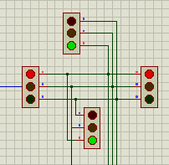
INTRODUCTION
A traffic light system is a crucial component of urban infrastructure designed to regulate vehicular and pedestrian traffic at intersections and crossings. Consisting of signal lights mounted on poles or overhead structures, the system uses a sequence of colours typically red, yellow and green to indicate when vehicles and pedestrians should stop or proceed.
The red light signals all traffic to stop, allowing vehicles from other directions to safely cross or turn. The green light indicates that vehicles and pedestrians may proceed in the designated direction. Yellow lights usually precede a red light, signaling a change from green to red soon.
Traffic light systems are designed to improve traffic flow, enhance safety, and minimize congestion by efficiently managing the movement of vehicles and pedestrians at intersections.

Slide 4
ANALYSIS & DESIGN OF A TRACFFIC LIGHT SYSTEM
To build this system using synchronous counter, we chose to use the D flip-flop because it is transprarent to the next state making the circuit easy to implement.
below is a state transition table of the D flip-flop.
TABLE
Q0 | Q1 | Q2 | Q’0 | Q’1 | Q’2 | D0 | D1 | D2
0 | 0 | 0 | 0 | 0 | 1 | 0 | 0 | 1
0 | 0 | 1 | 0 | 1 | 0 | 0 | 1 | 0
0 | 1 | 0 | 0 | 1 | 1 | 0 | 1 | 1
0 | 1 | 1 | 1 | 0 | 0 | 1 | 0 | 0
1 | 0 | 0 | 1 | 0 | 1 | 1 | 0 | 1
1 | 0 | 1 | 1 | 1 | 0 | 1 | 1 | 0
1 | 1 | 0 | 1 | 1 | 1 | 1 | 1 | 1
1 | 1 | 1 | 0 | 0 | 0 | 0 | 0 | 0

Slide 5
DEFINITION OF OUTPUT
From the state transition table above, we chose the following combinations to indicate red, green and yellow on our traffic light.
RED: It indicate that all vehicle should stop.
GREEN: It indicate that vehicle can move .
YELLO: It tell vehicle to get ready to move or stop.
RED/YELLO: The display of red/yellow at one side of the road indicate that a yellow is display on the other side of the road
LOGIC CIRCUIT
The logic circuit was belt using 3 Dflip-flops, AND gate, and XOR gate
RED | GREEN | YELLO | RED/YELLO
001 | 001 | 010 | 110

Slide 6
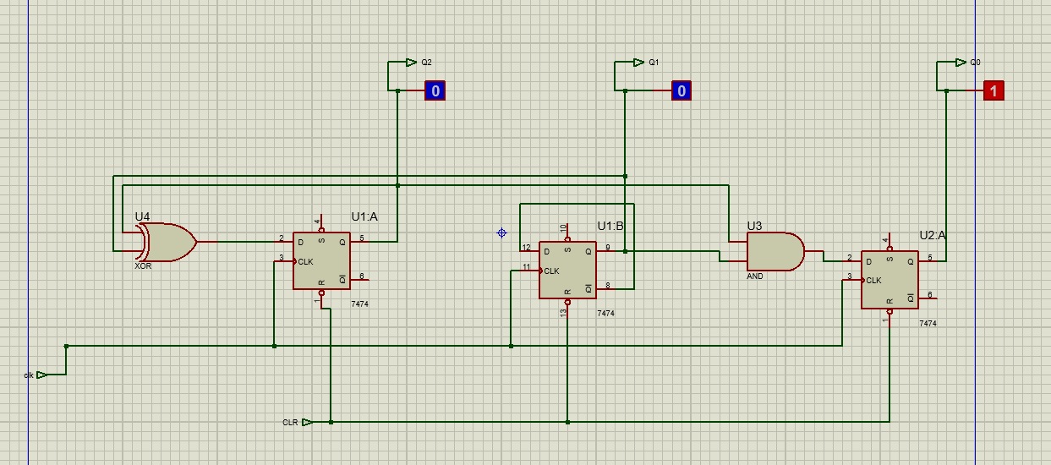
Logic Circuit

Slide 7
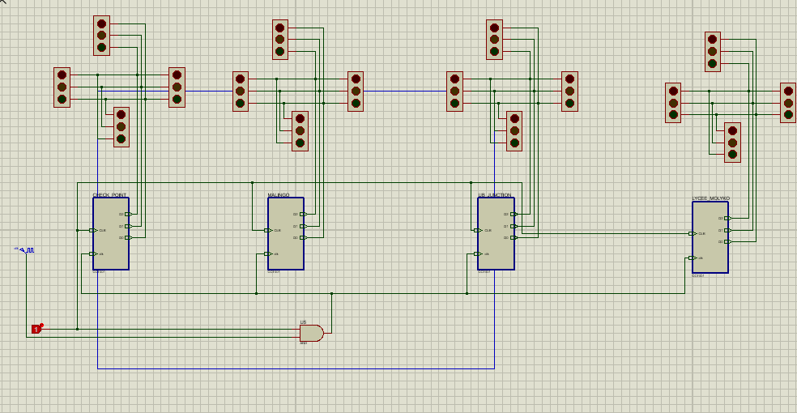
DESIGN

Slide 8
The main aim of this project was to design the traffic light alone specific junctions in Buea so the above design was rearrange to fit in the following junction.
UB junction
Malingo junction
Check point
And Biaka junction

Slide 9
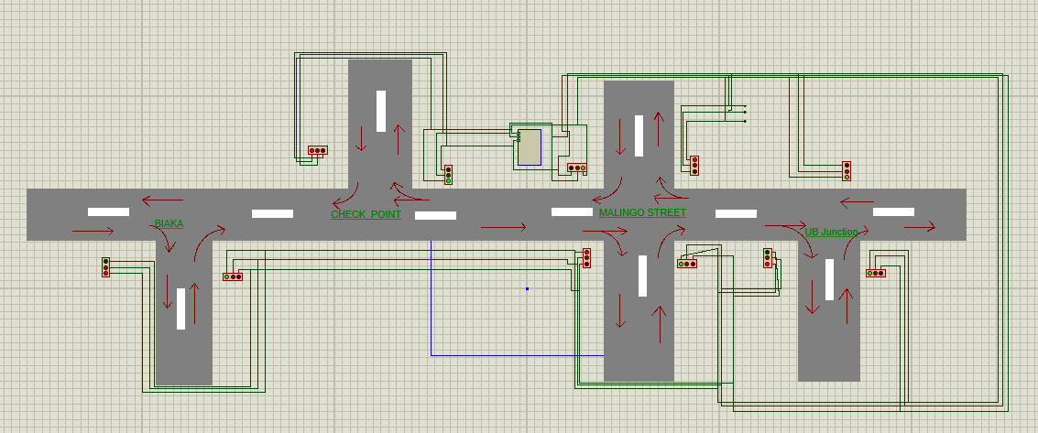
Rearranged Design

Slide 10
IMPLEMENTATION
The above logic circuit was cascaded to give the whole design of the traffic light and assimilated on Proteus.

Slide 11
CONCLUSION
In conclusion, the design of traffic lights plays a crucial role in managing urban traffic, enhancing safety, and optimizing efficiency at intersections. By carefully considering factors such as visibility, timing, technology integration, and accessibility, traffic light systems contribute significantly to smoother traffic flow and improved overall urban mobility. As cities evolve, ongoing advancements and adaptations in traffic light design will continue to be pivotal in meeting the dynamic needs of modern transportation infrastructure.

